Slide 1

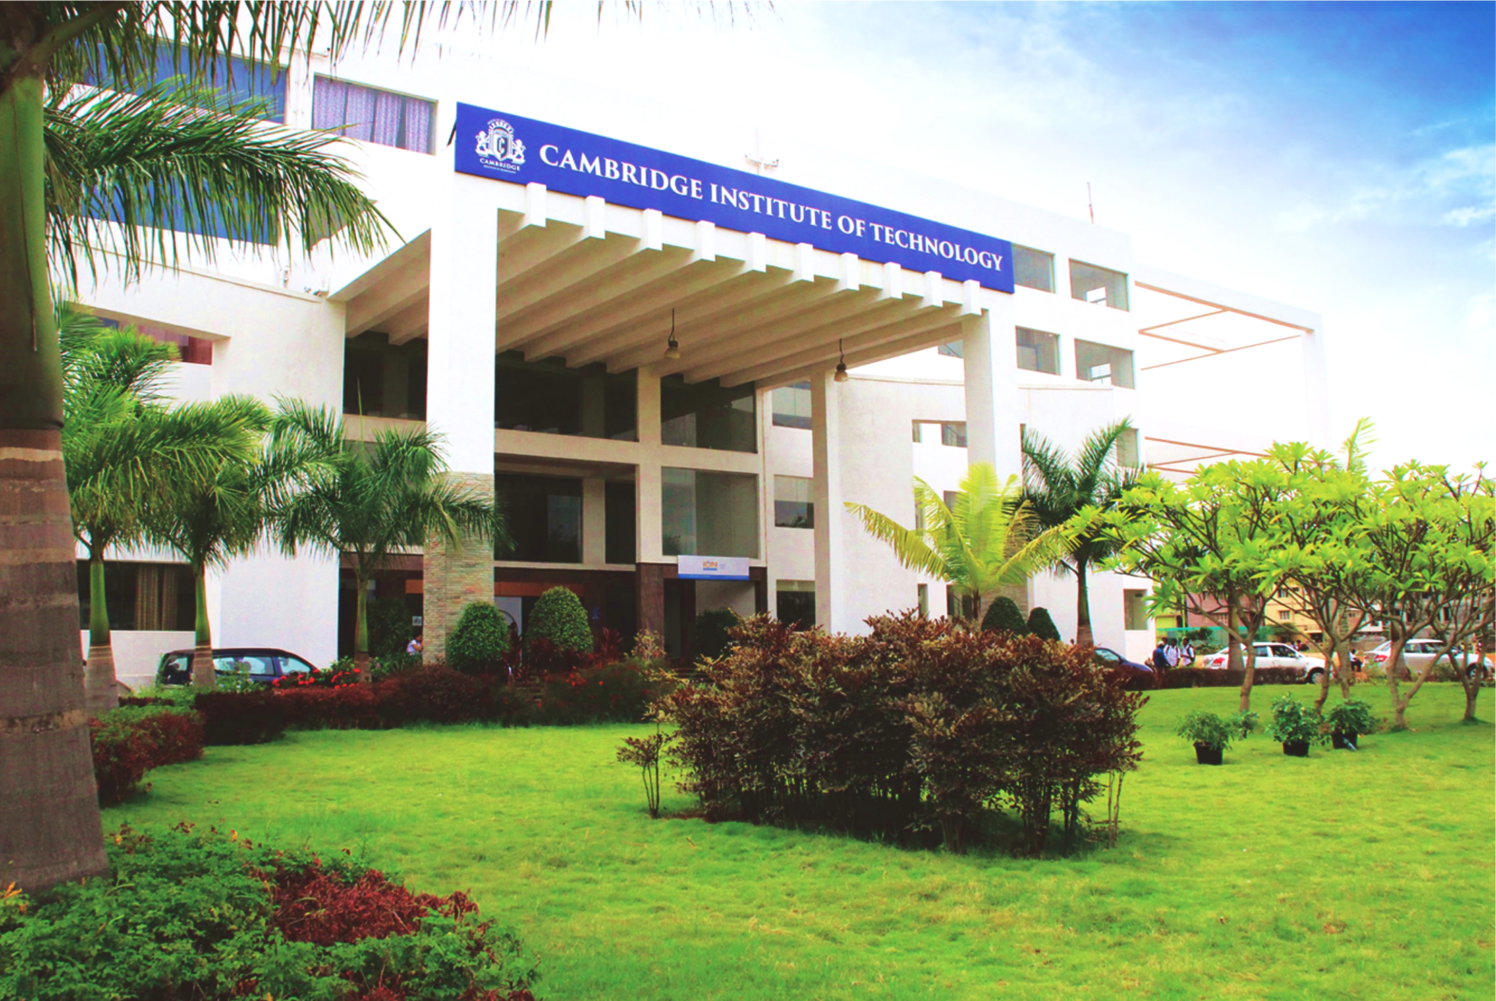
www.cambridge.edu.in
ML MINI PROJECT
Project Name:
RAG pipeline for LLMs to create a HealthCare
Chatbot.
Presented By :
Nohin Zachariah Varghese 1CD20AI000
Department of Artificial Intelligence and Machine Learning

Slide 2
Introduction
The development of healthcare chatbots has seen remarkable advancements with the integration of sophisticated AI techniques, particularly the Retrieval-Augmented Generation (RAG) pipeline and models like Mistral 7B.
The RAG pipeline enhances the chatbot's capabilities by combining retrieval-based methods, which fetch relevant data from external sources, with generation-based approaches, enabling the generation of contextually accurate and informative responses. Mistral 7B, a state-of-the-art language model, further augments this system with its impressive capacity for understanding and generating human-like text. When applied to healthcare, this combination enables the creation of highly efficient and reliable chatbots that can assist in diagnosing conditions, providing treatment recommendations, and answering complex medical queries. This hybrid approach ensures that healthcare chatbots deliver accurate, timely, and contextually appropriate information, significantly improving patient care and support.
Department of Artificial Intelligence and Machine Learning www.Cambridge.edu.in

Slide 3
Literature Survey
SL NO | PAPER TITLE | JOURNAL NAME | DESCRIPTION | PROS | CONS
1 | AI Enabled NLP based Text to Text Medical Chatbot | IEEE | The basic idea is to construct a healthcare chatbot (MedBot) based on Artificial Intelligence and Natural Language Processing, which can identify the illness and provide necessary information about it prior to consulting or visiting a doctor, thereby making the MedBot more reachable and reducing healthcare costs. Some of these chatbots act as virtual medical assistants, teaching patients regarding their sickness and motivating them to have better health. | Real life applicability Vast medical term knowledge Fairly accurate diagnosis for common illnesses | Limited Scalability Higher Computational Costs Low conversational capability for slightly out of domain questions Need for Further Research
2 | A RAG Chatbot for Precision Medicine of Multiple Myeloma | medRxiv | An innovative Retrieval-Augmented Generation (RAG) based chatbot framework that harnesses the power of Natural Language Processing (NLP) and state-of-the-art language models to curate and analyze MM-specific literature and provide personalized treatment recommendations based on patient-specific genomic data | Detailed training data Real-Life Applicability Addresses the specific problem well | Need for Further Research. Not very useful for general cases as its for a specific application. No user friendly interface.
Department of Artificial Intelligence and Machine Learning www.Cambridge.edu.in

Slide 4
Problem Statement
" Developing a Healthcare Chatbot using a Retrieval-Augmented Generation (RAG) pipeline to provide accurate, real-time medical information by combining the capabilities of Large Language Models (LLMs) with a retrieval mechanism."
Department of Artificial Intelligence and Machine Learning www.Cambridge.edu.in

Slide 5
Objectives
Enhance Information Accuracy: Utilize the RAG pipeline to provide accurate, up-to-date medical information by retrieving data from trusted healthcare sources.
Improve Response Relevance: Ensure that the chatbot can generate context-specific answers by combining retrieved information with generation-based responses.
Support Healthcare Professionals: Assist doctors, nurses, and other healthcare professionals with quick access to relevant medical knowledge, helping in diagnostics and treatment planning.
Patient Education: Provide patients with reliable information about symptoms, conditions, and treatments, improving health literacy and empowering them to make informed decisions.
Reduce Workload: Automate routine inquiries and tasks, reducing the administrative burden on healthcare staff and allowing them to focus on more complex patient care activities.
Continuous Improvement: Implement mechanisms for feedback and continuous learning, allowing the chatbot to improve its performance and accuracy over time.
Department of Artificial Intelligence and Machine Learning www.Cambridge.edu.in

Slide 6
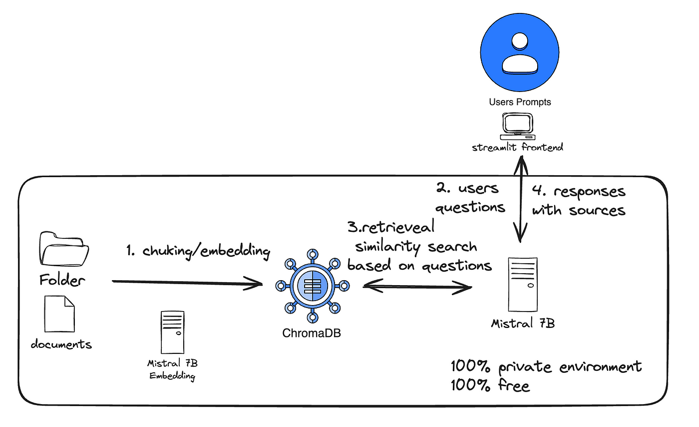
Methodology/Architecture
Medical
terms
Department of Artificial Intelligence and Machine Learning www.Cambridge.edu.in

Slide 7
Retrieval-Augmented Generation (RAG):
Combines retrieval-based and generation-based methods to enhance the accuracy and relevance of responses.
Retrieves relevant information from external knowledge sources in real-time.
Provides up-to-date and context-specific answers, particularly useful in dynamic fields like healthcare.
Helps overcome the limitations of static knowledge in traditional LLMs.
Improves the reliability and precision of responses in various applications, from chatbots to advanced data analysis.
Department of Artificial Intelligence and Machine Learning www.Cambridge.edu.in

Slide 8
StreamLit:
User-Friendly Interface: Streamlit provides a straightforward and intuitive interface for building and deploying data-driven web applications, making it accessible for users with minimal web development experience.
Rapid Prototyping: Developers can quickly create interactive applications and dashboards by writing simple Python scripts, significantly reducing the time needed for prototyping and iteration.
Integration with Python Ecosystem: Streamlit seamlessly integrates with popular Python libraries such as Pandas, NumPy, and Matplotlib, allowing for easy incorporation of data manipulation and visualization capabilities.
Real-Time Updates: Streamlit supports real-time updates, enabling applications to dynamically reflect changes in data or user input without requiring a page reload.
Open-Source and Extensible:As an open-source framework, Streamlit encourages community contributions and offers a wide range of plugins and extensions to enhance its functionality and adapt to various use cases.
Department of Artificial Intelligence and Machine Learning www.Cambridge.edu.in

Slide 9
LangChain:
A framework designed to facilitate the development of applications powered by language models.
Simplifies the integration of language models with external data sources and APIs.
Supports the creation of complex, multi-step workflows involving LLMs.
Provides tools for managing prompts, chains, and other components of LLM-powered applications.
Enhances the scalability and maintainability of language model-driven systems, enabling developers to build robust, production-ready applications.
Department of Artificial Intelligence and Machine Learning www.Cambridge.edu.in

Slide 10
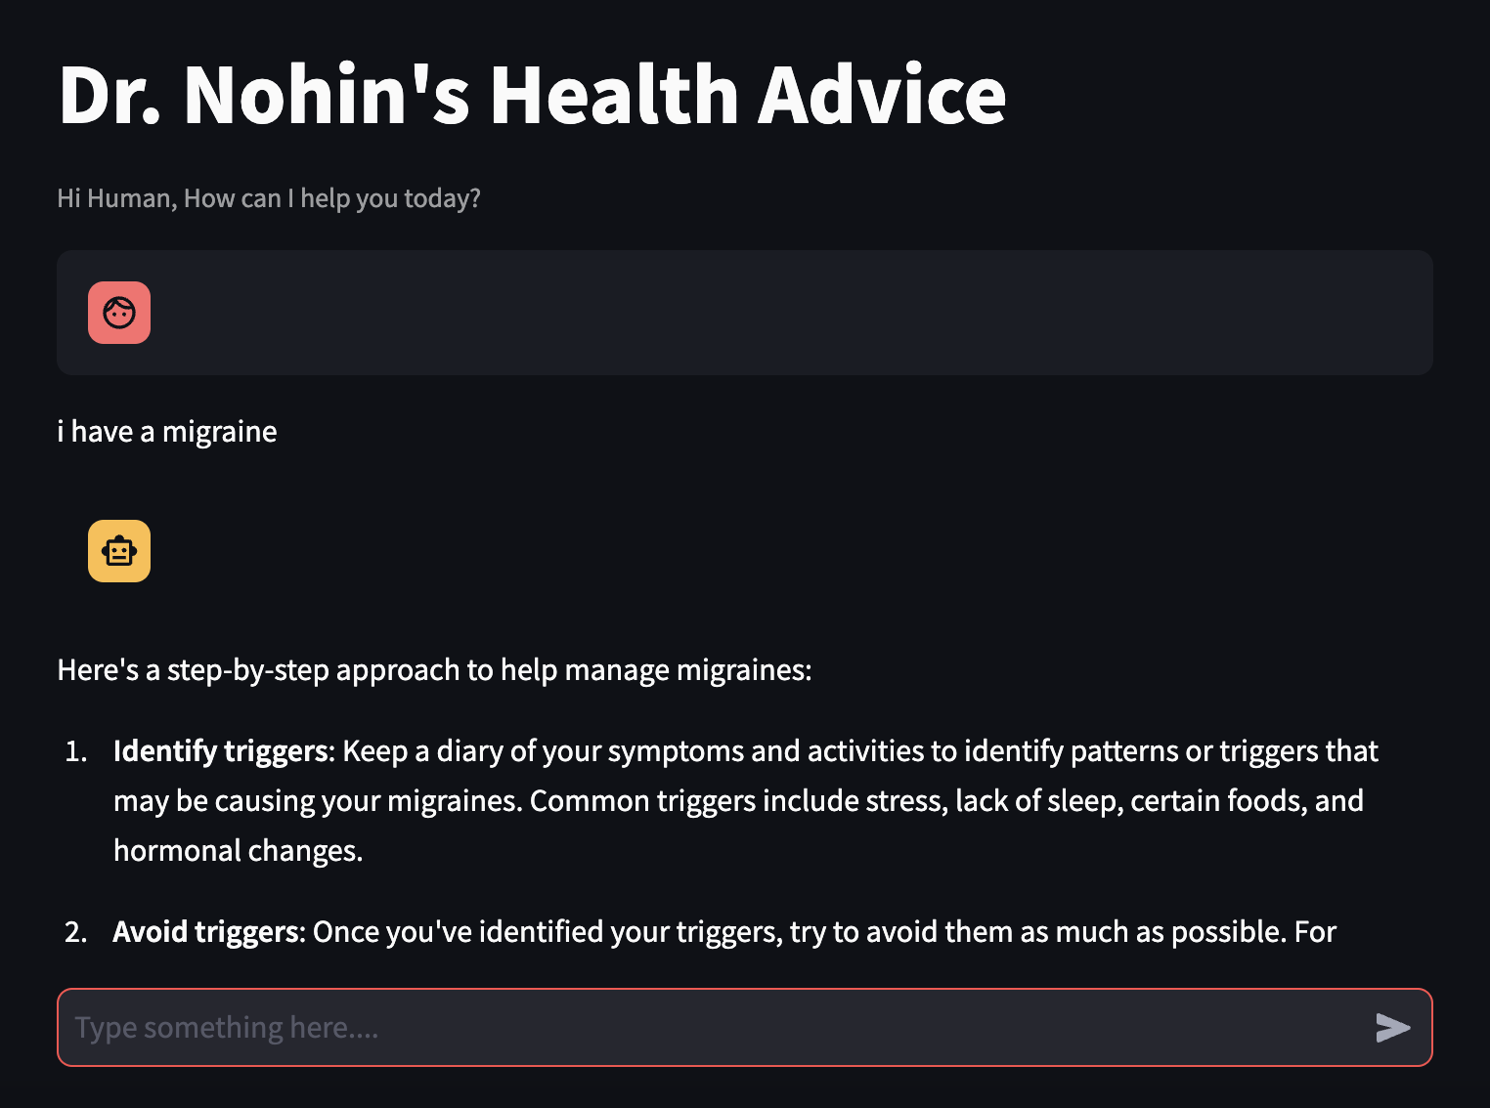
Results:

Slide 11
Applications:
Personalized Health Assessments: The health advisor can conduct personalized assessments based on user inputs, providing tailored advice on lifestyle changes, diet, exercise, and preventive measures to enhance overall health.
Virtual Health Consultations: Facilitate virtual consultations by offering initial evaluations and recommendations, helping users decide whether to seek in-person medical care and preparing them for their doctor's visits.
Health Education and Awareness: Disseminate accurate and easy-to-understand health information, raising awareness about common health issues, preventive measures, and the importance of regular check-ups.
Nutrition and Fitness Guidance: Offer customized nutrition plans and fitness routines based on user goals, health status, and preferences, promoting a healthier lifestyle and aiding in weight management.
Monitoring and Follow-Up: Track users' health metrics and progress over time, providing regular follow-ups and reminders for medication, check-ups, and healthy habits to ensure ongoing health management.
Department of Artificial Intelligence and Machine Learning www.Cambridge.edu.in

Slide 12
Conclusion
Leveraging advanced technologies such as the Retrieval-Augmented Generation (RAG) pipeline and frameworks like Streamlit holds significant promise for developing robust healthcare chatbots. These tools enhance the accuracy, relevance, and accessibility of medical information, benefiting both healthcare professionals and patients. By integrating real-time data retrieval, interactive user interfaces, and personalized responses, these innovations can streamline healthcare delivery, improve patient outcomes, and support the ongoing evolution of digital health solutions.
Department of Artificial Intelligence and Machine Learning www.Cambridge.edu.in

Slide 13
Future Work
Enhanced Multilingual Support: Develop and integrate multilingual capabilities to serve a diverse, global user base, ensuring that accurate medical information is accessible in multiple languages.
Integration with Wearable Devices: Incorporate data from wearable health devices to provide real-time monitoring and personalized health recommendations based on continuous data inputs.
Advanced Natural Language Understanding: Improve natural language understanding to handle more complex medical queries and conversations, enhancing the chatbot's ability to provide nuanced and contextually appropriate responses.
Predictive Analytics: Implement predictive analytics to forecast potential health issues based on user data and trends, enabling proactive healthcare interventions.
Ethical AI and Bias Mitigation: Focus on developing ethical AI practices and techniques to identify and mitigate biases in the chatbot’s responses, ensuring fair and unbiased healthcare support for all users.
Department of Artificial Intelligence and Machine Learning www.Cambridge.edu.in

Slide 14
References
https://js.langchain.com/v0.2/docs/integrations/chat/mistral/
https://huggingface.co/mistralai/Mistral-7B-Instruct-v0.2/discussions/78
Department of Artificial Intelligence and Machine Learning www.Cambridge.edu.in

